Slide 1
Processes
Module CSN08101
Systems and Services
School of Computing Napier University

Slide 2
Learning Outcomes
➘ This lecture is intended to help you to:
➘ Understand the concepts of logical and physical address spaces.
➘ Understand the organisation of processes in memory.
➘ Further develop the ideas of processes.

Slide 3
Processes
➘ The process is the main idea of “activity” or “work” in the OS.
➘ The sequence of activity inside the OS is a cycle of “processes”:
sBi sCi sDi sEi sBi sCi sDi sEi sBi sCi sDi sEi sBi sCi ... etc.
where B, C, D and E are tasks of some sort, and s and i are
respectively the scheduler and interrupt controller from the OS
kernel.
➘ What this means is that the program counter is pointing to instructions
from that process, and the other registers hold data from that
process.
➘ When an interrupt occurs the “context” switches to another process
➘ The registers now contain information from that other process.
➘ This section explains:
➘ the relationship between programs and processes,
➘ what a process consists of in the computer, and
➘ how decisions are made about which process should run.
(next lecture)

Slide 4
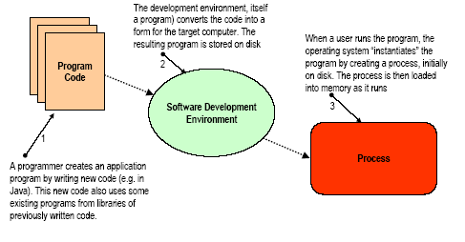
From program to process -1

Slide 5
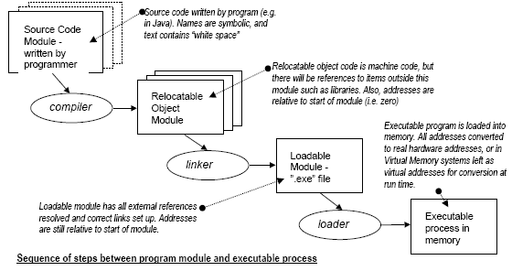
From program to process -2

Slide 6
From program to process -3
➘ The programmer writes modules in a programming language (e.g. Java).
➘ These modules may refer to other modules written earlier (e.g. library
modules containing maths functions, or code modules created by
colleagues).
➘ The final “program” could contain several modules and is produced by:
➘ “compiling” - translating from the text of the language to machine code.
➘ “linking” - bringing a set of modules (each of which may have overlapping
addresses) together into one program, with a single range of addresses.
➘ The linked program has a logical address space, starting from zero.
➘ All of the instructions, data and resources used by the process are
addressable by references to points (addresses) in that space.
➘ The program is now represented by a file, probably stored on a disk.
➘ Typically this called “something.exe” meaning the file is “executable”.
➘ To run the program, a user would click on the icon for something.exe on the
desktop , or type a command of the form “run something.exe”.
➘ The operating system creates a process for the program.

Slide 7
From program to process -4
➘ The process for the program is created initially on the disk in an area of the disk called the “swap” file or “page” file (e.g. “pagefile.sys” in NT/XP)
➘ The process has a logical address space which starts at zero and covers
every address up to 4GB.
➘ Clearly, no ordinary computer can hold such a large process in memory.
➘ The memory is a “physical address space” (typically 128-256 MB).
➘ To run the process, portions of it are copied (or “loaded”) from disk into memory as they are needed. The portions are called “pages”.
➘ During loading, the logical addresses of the program are “mapped” to the physical addresses of the part of memory used.
➘ If a program is run several times there is no guarantee the same
physical memory will be used each time.
➘ Every logical address must be converted individually each time the
program is run.
➘ This conversion can be done by memory management hardware.

Slide 8
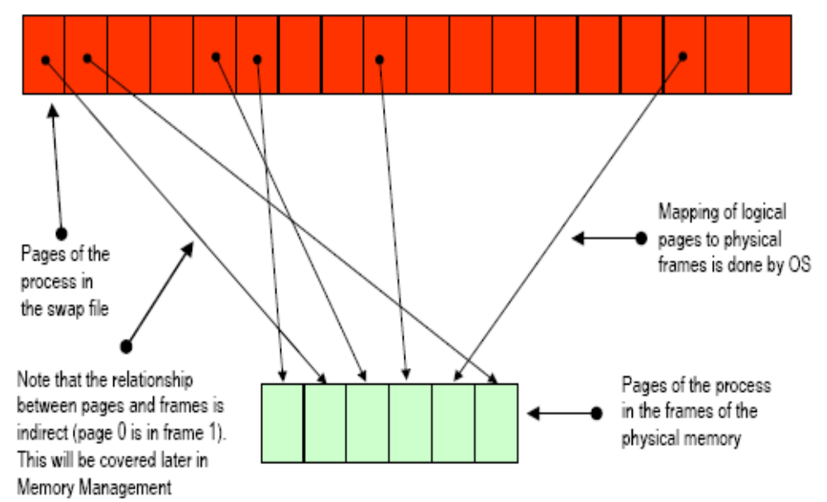
Mapping logical to physical addresses

Slide 9
Program Address Space -1
➘ The Fetch/Execute model shows how instructions and data are stored in memory and “read” from there into the CPU as the program runs.
➘ As well as instructions and data embedded in the program, every device
or service, with which a program interacts, appears as an address, or a set
of addresses, in memory.
➘ When a process reads the keyboard it fetches a value which has been
placed in a certain memory location by the keyboard hardware.
➘ Displaying a character means writing the character into another
memory location from which the display hardware will put it on the screen.
➘ Reading a disk file means that the hardware controlling the disk copies
blocks of data from the disk, and stores them in a range of memory
locations in the address space from which the programme can “read”
them.
➘ As the program is running, the logical address space of the program must be mapped by the OS on to real physical hardware addresses.

Slide 10
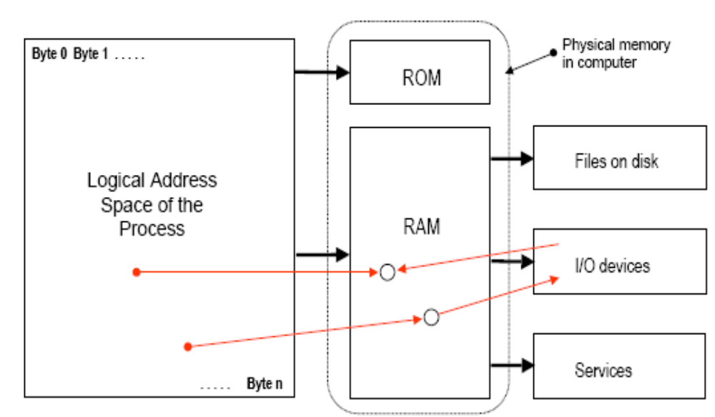
Program Address Space -2

Slide 11
Programs and Processes - 1
➘ A Process is a unit of processing :
➘ It can be scheduled (allocated to a processor) when its
resource requirements can be met (i.e. all devices needed are
free), and a processor is available.
➘ A Resource is any component of the system needed by the process as it executes:
➘ For example, memory, display devices, input devices,
network connections.
➘ All resources have interfaces that define how they can be
obtained and used.
➘ A File is a unit of information storage :
➘ In effect, a special form of resource.
➘ Files hold information to be manipulated or created by
processes.
➘ As before, the file storage sub-system has a defined
interface.

Slide 12
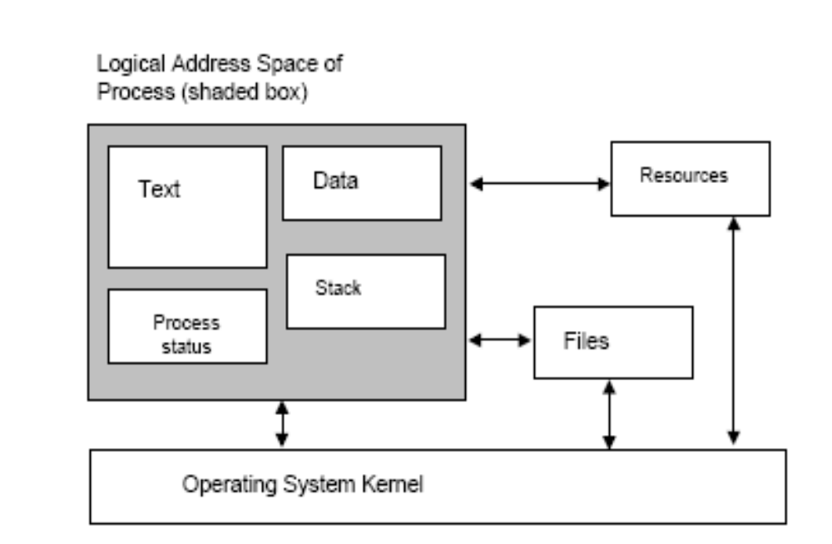
Programs and Processes - 2

Slide 13
Programs and Processes - 3
➘ A Program -
➘ is a static entity consisting of a generalised behaviour described by
statements and generic data.
➘ A Process -
➘ can be considered as a sequential program in execution. It is
therefore a dynamic entity, comprising:
➘ “machine” code defining the behaviour of the process. This is usually
held in the “Text segment” of the process.
➘ Data being used by the process. The “Data segment” holds static
data (e.g. data may be obtained from outside the process (from a file or
other resource), while the “Stack segment” holds dynamic data (e.g.
variables created while the program is running).
➘ Process status - housekeeping details plus the register save area.

Slide 14
Programs and Processes - 4
➘ The distinction exists in other areas between:
➘ static generalised behaviour encoded in rules or instructions, and
➘ specific instances of dynamic activity arising from it.
➘ A recipe for a pasta dish is a program.
➘ Making a specific dish of that pasta from that recipe is a
process.
➘ A knitting pattern for a sweater is a program.
➘ Making a particular red sweater from that pattern is a process.
➘ Plans for a detached house are a program.
➘ Building a specific house on a specific site is a process.
➘ In each case the specific instance of the process accepts inputs (pasta,
wool or bricks) and produces outputs (food, sweater, house).
➘ A word processor is the generalised behaviour needed to write a
document.
➘ Using it to produce a specific report requires a process to run which
accepts inputs from keyboard and files and generates the report file.

Slide 15
Re-entrant (or shareable) programs
➘ If several copies of the same program are running simultaneously the code segments will be the same - This wastes memory.
➘ Some language compilers produce “re-entrant code”
➘ The code segment of each process is replaced by a link, or pointer, to a single
code segment which can be used by several processes simultaneously.
➘ Each process has its own data, resources and status.
➘ Thus we have several processes sharing a single program text.
➘ Each process will produce a different (correct) result from applying the
same program to different sets of data.
➘ A program reads two integer numbers, x and y, and displays their sum.
➘ The data segment for process 1 might hold 3, 4 and the sum: 7
➘ The data segment for process 2 might hold 150, 200 and the sum: 350
➘ Each process would share the same code segment with sum := x + y
➘ When process 1 is running the addresses for x and y are in its data
segment
➘ When process 2 is running the addresses for x and y will be in the data
segment for process 2.

